Slide 1
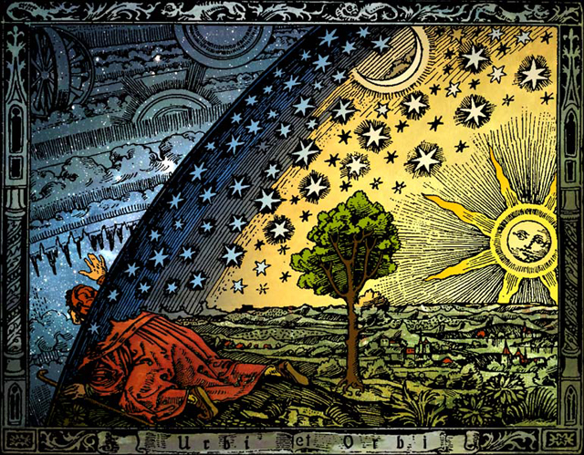
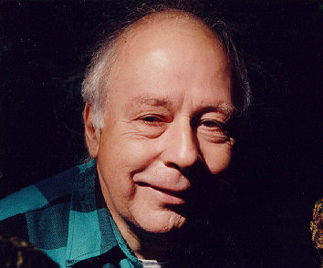
TALES About NAD+
3rd Annual
NAD⁺ Summit
3rd Annual
NAD Summit
January 27-28th
Catamaran Hotel
San Diego, California
Vince Giuliano, PhD
www.agingsciences.com
With Major contribution by Dr. James P Watson

Slide 2
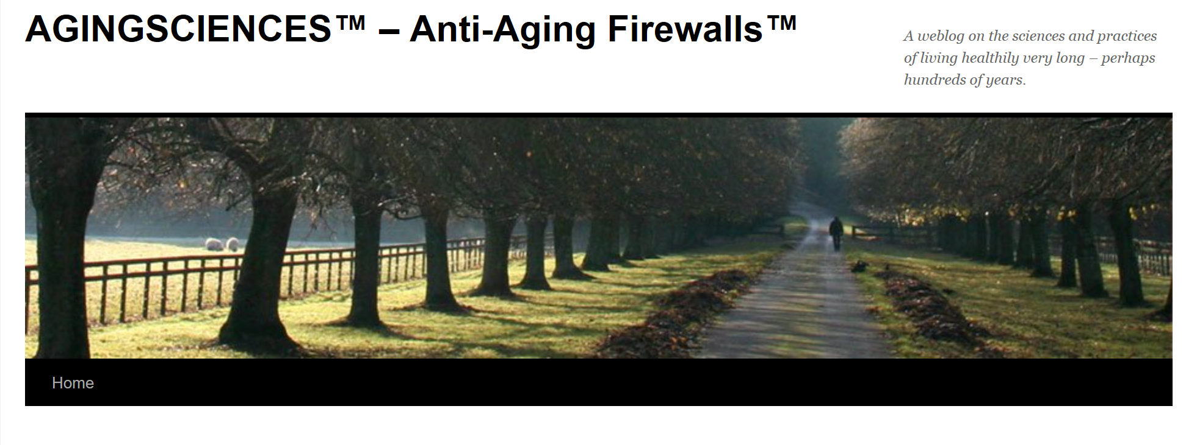
For More Information on NAD+ Biology and Aging
Easy to Read Blogs on NAD⁺
Part I – NAD⁺ de novo synthesis, NAD⁺ salvage pathway, the 7
Sirtuins, CD38, the 17 PARPs, Circadian regulation of NAD⁺
synthesis, Critical role of NAD⁺ in the mitochondria
and NAD+ deficiency causing pseudohypoxic state
Part II – Redox vs Cofactor roles of NAD⁺, restoring cellular
NAD⁺ levels, Major functions of SIRT1 and SIRT6
Part III – 30 major factors that control SIRT1 gene expression,
SIRT1 enzyme activity, and SIRT1-mediated aging
Part IV – NQO1 regulation of NAD⁺/NADH ratio, NAD⁺ Mand
Warburg metabolism, NAD⁺ and inflammation
Part V – Conflicting roles of extracellular NAMPT enzyme
(eNAMPT) and why it causes systemic inflammation
Part VI – How Google is getting into NAD+ businesss, why Google’s
strategy will fail, why NR/NMN/NAD+ will not stop aging, (coming)
Vince Giuliano, PhD
www.agingsciences.com
Mostly by Jim Watson

Slide 3
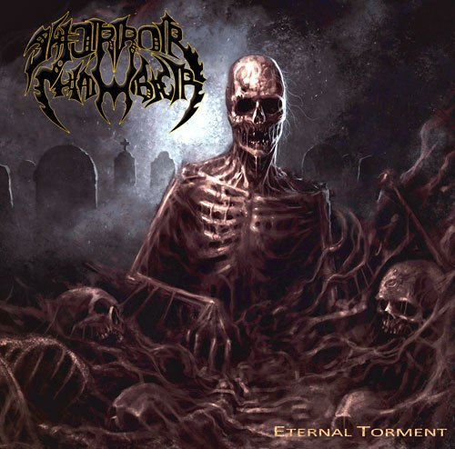
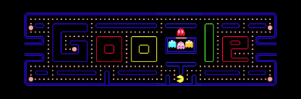
Summary of Today’s Lecture
3rd Annual
NAD⁺ Summit
1. Fundamental “NAD⁺ Stories ”
Co-enzyme vs Cofactor functions of NAD⁺, declining NAD⁺,
declining NAD⁺/NADH ratios, and declining cellular redox
potentials with aging, NAD+ functions in each subcellular
compartment, sources of NAD⁺ biosynthesis in the cell
2. NAD⁺ “Chamber of Horrors ”
  Some of the main things that can go horribly wrong if you don’t have enough NAD⁺ in your body or your or if your NAD+/NADH ratio goes screwy
3. NAD⁺ “Pac-men ”
Enzymes that can eat up your NAD+ while you are not
looking – SIRTs, PARPs, CD38, MARTs, SARM-TIR

Slide 4

screwy:
One dark, dark night, your NAD/NADH ratio
dropped really low
NAD⁺
Stories

Slide 5
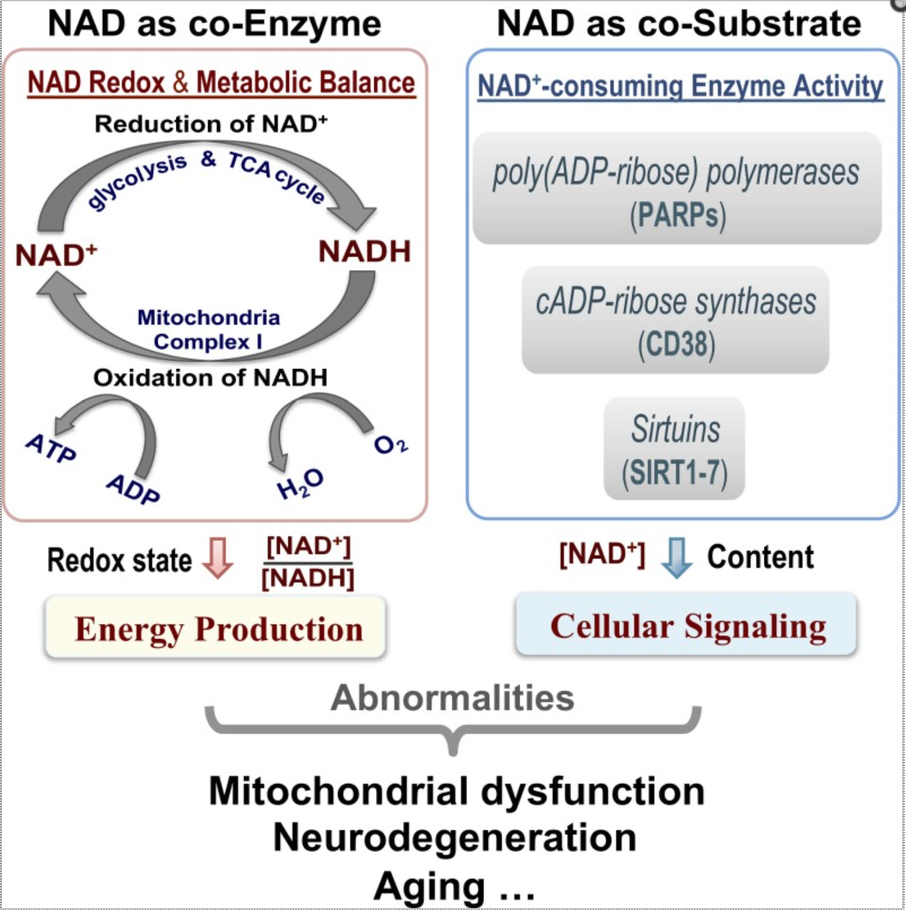
Fundamental NAD+ StorY:
NAD⁺ Consuming vs Non-consuming Processes
3rd Annual
NAD⁺ Summit
NAD⁺ Is NOT Consumed
NAD⁺ Is Consumed

Slide 6
Fundamental NAD+ Aging Stories:
Aging is manifested by Two NAD⁺-related Stories
3rd Annual
NAD⁺ Summit
Poor Cellular
Redox State
(> -300 mV)
Low Cellular
NAD⁺ levels
( < 0.30 mM)
* Zhu, et.al., PNAS, March, 2015, Vol 112, pp 2876- 2881

Slide 7
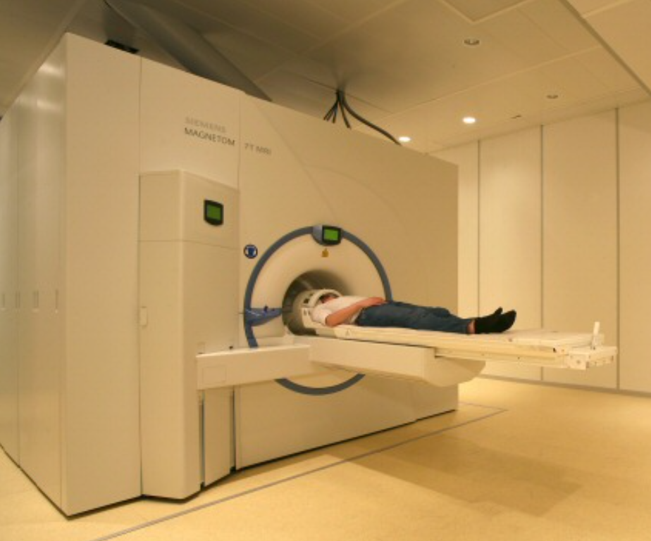
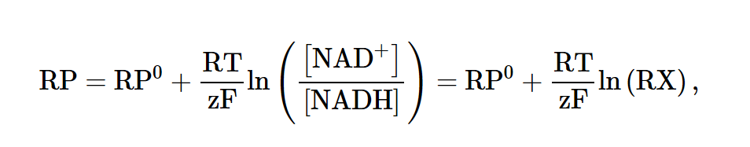
measuring NAD+ in the Brain
3rd Annual
NAD⁺ Summit
Measuring NAD+ in vivo in Live Humans
Brain Ultrahigh-field (7 T) ³¹P
Magnetic Resonance Spectroscopy
Measures brain ATP, NAD⁺,
and NADH simultaneously
NAD⁺/NADH ratio derivation:
* Zhu, et.al., PNAS, March, 2015, Vol 112, pp 2876- 2881

Slide 8
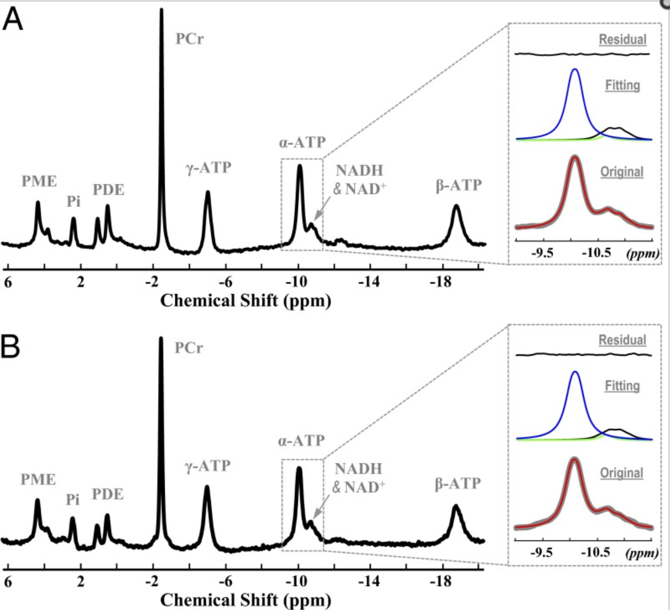
measuring NAD+ in the Brain
3rd Annual
NAD⁺ Summit
Ultrahigh-field (7 T) ³¹P Magnetic Resonance Spectroscopy
18 year-old healthy male
ATP, NADH & NAD+ in occipital lobe
36 year-old healthy male
ATP, NADH & NAD+ in occipital lobe
* Zhu, et.al., PNAS, March, 2015, Vol 112, pp 2876- 2881

Slide 9
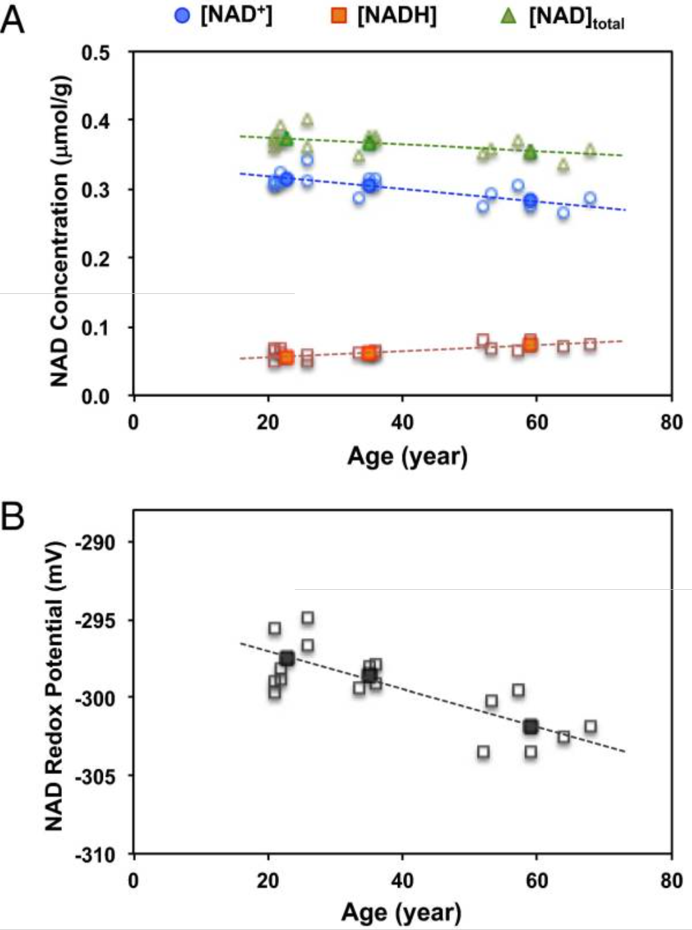
Fundamental NAD+ Stories
3rd Annual
NAD⁺ Summit
Intracellular
NAD+ Levels
Decline with
Aging in the
Brain
In Vivo Measurement of NAD+ in the Brains of 17
healthy patients, using 31P (7T) MRS Imaging *
* Zhu, et.al., PNAS, March, 2015, Vol 112, pp 2876- 2881
Notes:
From The Article Titled: “In vivo NAD assay reveals the intracellular NAD contents and redox state in healthy human brain and their age dependences” by Xiao-Hong Zhu, Ming Lu, Byeong-Yeul Lee, Kamil Ugurbil, and Wei Chen, PNAS,, 2015 Mar 3; 112(9): 2876–2881
Age dependences of (A) intracellular NAD⁺, NADH, and total NAD concentrations and (B) NAD⁺/NADH RP observed in healthy human brains. The open symbols represent individual subject data, and the filled symbols display the average data from three age groups of younger (21–26 y old; n = 7), middle (33–36 y old; n = 4), and older (59–68 y old; n = 6) subjects.

Slide 10
Fundamental NAD+ Stories
3rd Annual
NAD⁺ Summit
Redox
Potential
of Brain
Cells Decline
with Aging
In Vivo Measurement of Redox Potential in the Brains
of 17 healthy patients, using 31P (7T) MRS Imaging *
* Zhu, et.al., PNAS, March, 2015, Vol 112, pp 2876- 2881
Notes:
From The Article Titled: “In vivo NAD assay reveals the intracellular NAD contents and redox state in healthy human brain and their age dependences” by Xiao-Hong Zhu, Ming Lu, Byeong-Yeul Lee, Kamil Ugurbil, and Wei Chen, PNAS,, 2015 Mar 3; 112(9): 2876–2881
Age dependences of (A) intracellular NAD⁺, NADH, and total NAD concentrations and (B) NAD⁺/NADH RP observed in healthy human brains. The open symbols represent individual subject data, and the filled symbols display the average data from three age groups of younger (21–26 y old; n = 7), middle (33–36 y old; n = 4), and older (59–68 y old; n = 6) subjects.

Slide 11



The 3 outcomes of NAD+ levels
3rd Annual
NAD⁺ Summit
Longevity
Disease
(Low Redox
Potential,
Low NAD⁺
Low NAD/
NADH Ratio)
Death
(Very Low NAD⁺
Very Low NAD/
NADH ratio)
NAD = 0.30 mM
intracellular NAD/NADH ratio
= 4.8 in brain
Redox potential
= −299.3 mV in
brain on ³¹P MRS*
* Zhu, et.al., PNAS, March, 2015, Vol 112, pp 2876- 2881
Notes:
From The Article Titled: “In vivo NAD assay reveals the intracellular NAD contents and redox state in healthy human brain and their age dependences” by Xiao-Hong Zhu, Ming Lu, Byeong-Yeul Lee, Kamil Ugurbil, and Wei Chen, PNAS,, 2015 Mar 3; 112(9): 2876–2881
By using the α-ATP resonance signal as an internal standard and assuming [ATP] = 2.8 mM in the normal brain tissue (17, 21, 22), we were able to noninvasively obtain quantitative data for the human brain on 17 healthy subjects spanning the ages of 21–68 y old. The results yielded the following intracellular concentrations: [NAD⁺] = 0.30 ± 0.02 mM or 0.27 ± 0.02 μmol/g (after a unit conversion using a brain tissue density of 1.1 g wet brain tissue per 1 mL), [NADH] = 0.06 ± 0.01 mM or 0.06 ± 0.01 μmol/g, and total NAD ([NAD]_{total} = [NAD⁺] + [NADH]) = 0.37 ± 0.02 mM or 0.34 ± 0.02 μmol/g. Consequently, the intracellular NAD⁺/NADH redox ratio (RX; RX = [NAD⁺]/[NADH]) and redox potential (RP) were calculated to be 4.8 ± 0.9 and −299.3 ± 2.5 mV, respectively.

Slide 12
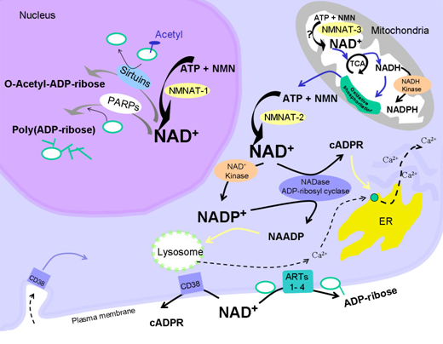
Fundamental NAD+ Stories
3rd Annual
NAD⁺ Summit
NAD⁺ and NADP⁺
Play a vital and
unique role in
each subcellular
compartment
of the cell

Slide 13
Fundamental NAD+ Stories unique subcellular roles of NAD⁺ and NADP⁺
3rd Annual
NAD⁺ Summit
Roles of NAD+ in Cell Nucleus
SIRT1 – Histone deacetylation,
repetitive DNA silencing
SIRT6 – Histone ADP-ribosylation
telomere maintenance
SIRT7 – Vital role in nucleolus
PARP1 – DNA repair
PARP2 – DNA repair
Tankyrases (aka PARP) – Telomere
maintenance
NMNAT-1 – converts NMN
into to NAD+ in the nucleus

Slide 14
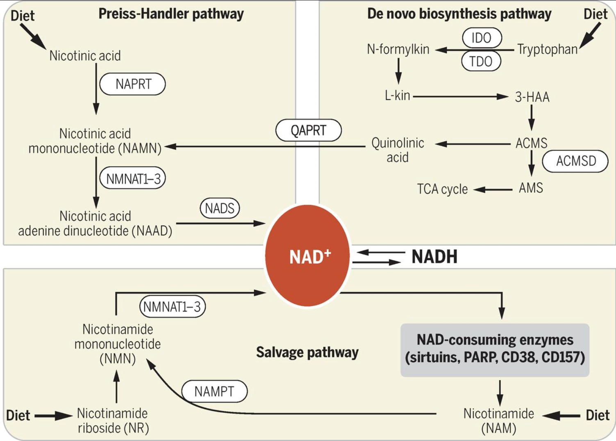
Fundamental NAD+ Stories
3rd Annual
NAD⁺ Summit
“Mommie, Where does NAD+ Come From”?
5 Ways to Get NAD⁺
Preiss-Handler Pathway (NAD⁺ made from dietary nicotinic acid)
De novo Pathway (NAD⁺ made
from tryptophan via quinolinic a.)
Salvage Pathway (NAD+ made
from nicotinamide, byproduct of
NAD⁺ consumption by SIRT, etc.)
Exogenous NAD+ precursors
(made from Nicotinamide Riboside
or Nicontinamide Mononucletide)
Exogenous NAD+ (given IV, intra-
nasally, or transdermally with
iontophoresis)

Slide 15
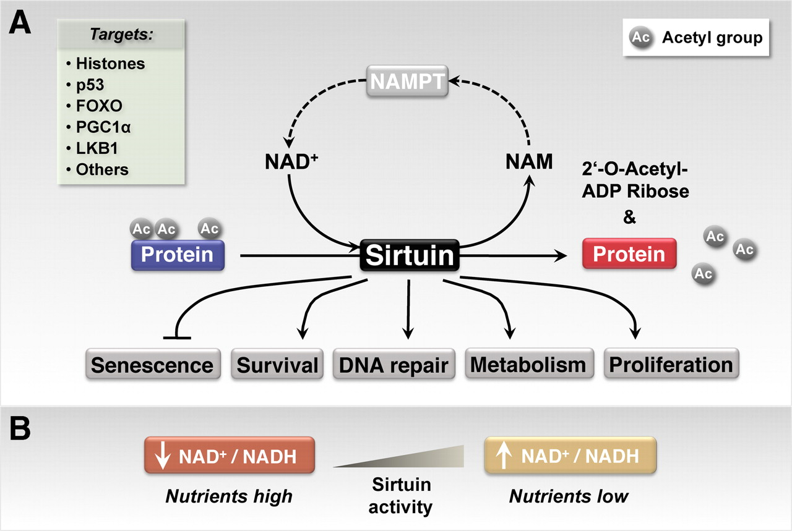
Fundamental NAD+ Stories
The “7 Sirtuin Stories”
3rd Annual
NAD⁺ Summit
The “7 Sirtuin
Stories” are the
most well-studied
roles of NAD⁺ as
a cofactor* in the cell.
*(i.e. where NAD+ is
consumed, vs being
converted to NADH)
NAD+
Salvage
Pathway

Slide 16
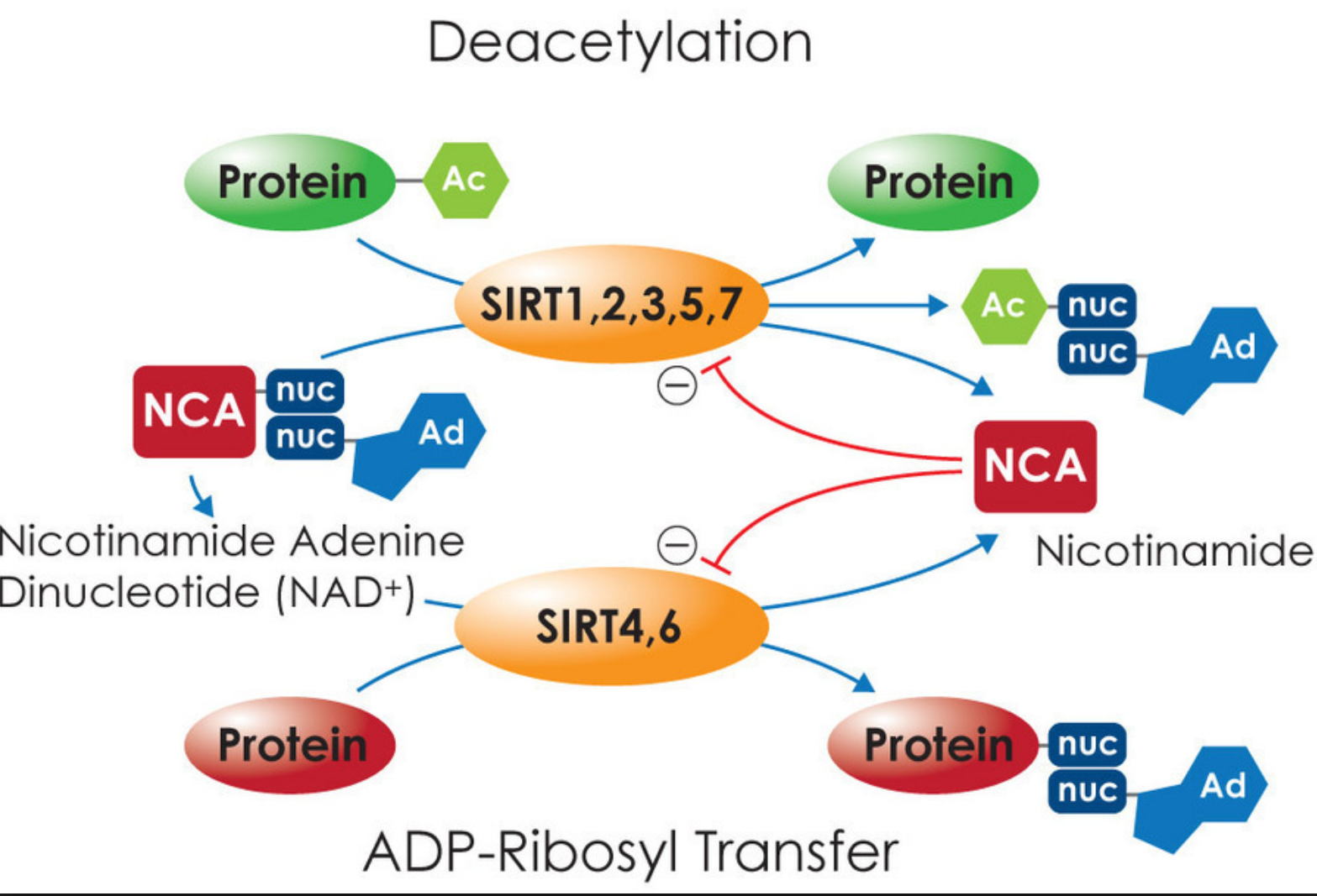
Fundamental NAD+ Stories
The “Sirtuin StorY”
3rd Annual
NAD⁺ Summit
NAD+ is an essential substrate
for the production of Sirtuins
NAD+ drives the Sirtuin-dependent
deacetylation of many key enzymes,
including eNOS, NF-kB, PGC-1a,
FoxOs, LKB1, and IRS1/IRS2.
NAD+ drives the Sirtuin-dependent
ADP-ribosylation of many proteins,
including histones
By NAD+-dependent deacetylation
of these enzymes, Sirtuins thereby
affect every major molecular
pathway that involves aging.
This is why many researchers believe restoring NAD+ levels in the cell is so
important for affecting the “cause” of aging, rather than the “effects” of aging.

Slide 17
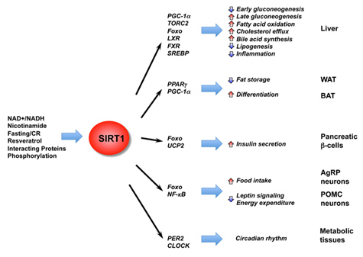
Fundamental NAD+ Stories
3rd Annual
NAD⁺ Summit
The “SIRT1 Story”
Key Points about SIRT1
Only SIRT activated by Resveratrol (SIRT2-7 are not activated by resveratrol)
Plays role in the nucleus and in the cytoplasm (histone deacetylation and transcription factor nuclear localization from cytoplasm)
Key role in glucose metabolism and insulin secretion (TORC2, FoxO, UCP2,
Key role in lipid trafficking (LXR, FXR, SREBP, PPAR, PGC-1)
Key role in circaidian clock (PER2, CLOCK)
Key role in reducing inflammation (FoxO, NF-kB)

Slide 18
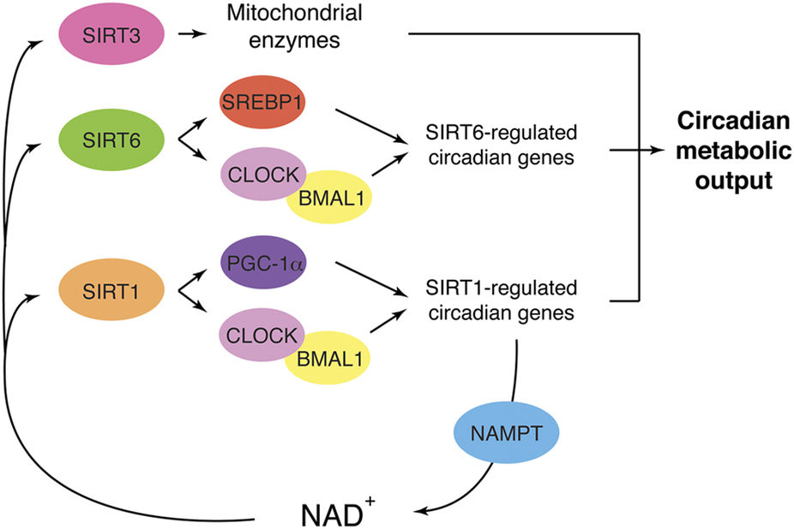
Fundamental NAD+ Stories
3rd Annual
NAD⁺ Summit
The “SIR-cadian Clock Story”
Sirtuins & Circadian Clocks
NAD+ and Sirtuins play
vital roles in circaidian
clock regulation of gene
expression. Approximately
11% of the human genome
Must be either “turned on”
Or “turned off” by this
SIRT1, SIRT3, and SIRT6
dependent molecular
clock system, present in
all 37 trillion human cells.

Slide 19
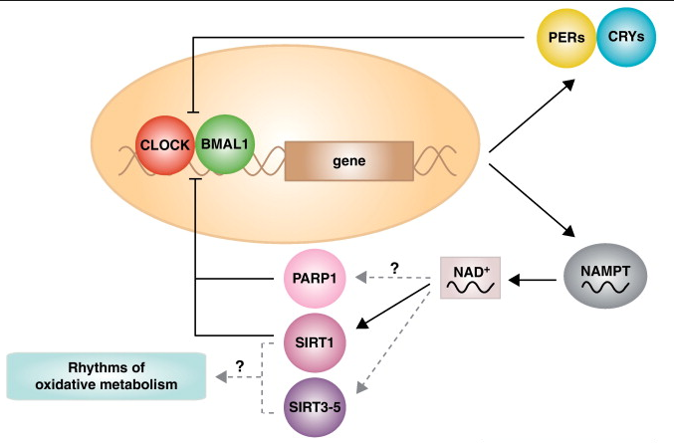
Fundamental NAD+ Stories
3rd Annual
NAD⁺ Summit
The “Circadian Gene Expression of NAMPT Story”
Circadian NAMPT Expression
NAD+ salvage is regulated by the rate-limiting step in the salvage cycle, which is the enzyme NAMPT.
NAMPT gene expression occurs in a circadian fashion – highest in the evening and at night.
If your circadian rhythms and body clocks are off, NAD+ and Sirtuin enzyme levels may be too low, resulting in body circadian clocks not work well.

Slide 20
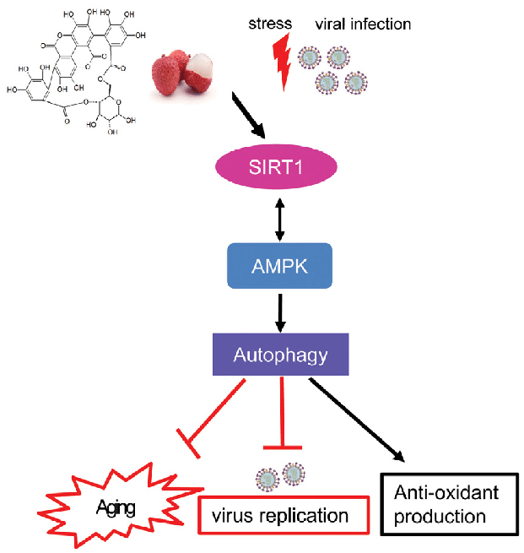
Fundamental NAD+ Stories
3rd Annual
NAD⁺ Summit
The “Autophagy Story”
NAD+ and SIRT1 play vital
roles in “ cellular house
cleaning”, akac autophagy.
Autophagy is the only way
cells can get rid of old damaged mitochondria, damaged cell membranes, and damaged, misfolded proteins. Also important in preventing virus infections, anti-oxidant protection
and preventing aging.

Slide 21
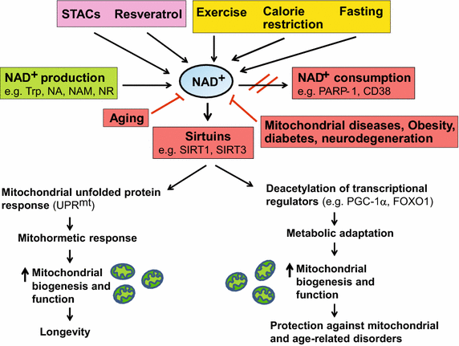
Fundamental NAD+ Stories
3rd Annual
NAD⁺ Summit
The “Mitochondria-NAD+ Story”
NAD+, Sirtuins and
Mitochondrial function
NAD+ and Sirtuins are required
for making new mitochondria
(aka mitochondrial biogenesis)
and mitochondrial function.
SIRT1 and SIRT3 are key for
Mitochondrial biogenesis.
SIRT3, SIRT4, and SIRT5 are
key for mitochondrial function.
SIRT3-5 are all localized to
inside of the mitochondria

Slide 22
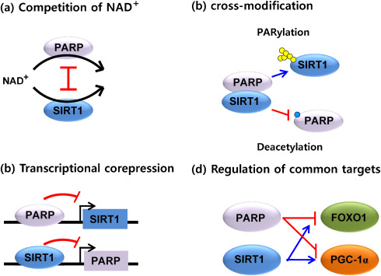
Fundamental NAD+ Stories
3rd Annual
NAD⁺ Summit
The “PARP-SIRT Competion” for NAD⁺ Story”
PARPs and SIRTs both require
plenty of NAD+ and a high
NAD/NADH ratio
Because of their mutal dependence
on NAD+ to function, there is a
natural competition between
the Sirtuin enzymes and the
PARP enzymes.
PARP enzymes and SIRT1 enzyme
have mutual negative feedback on
each other. PARPs inhibit SIRT1
and SIRT1 inhibits PARP.
PARPs and SIRT1 have opposite
effects on FoxO1 and PCG-1a

Slide 23
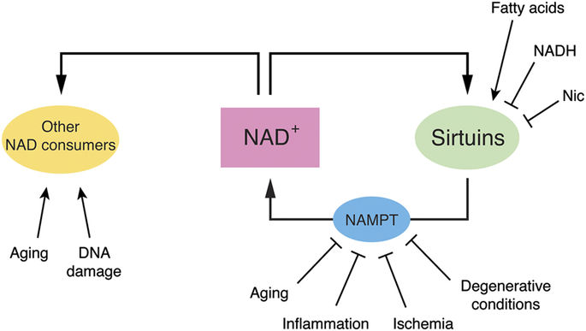
Fundamental NAD+ Stories
NAD+ and Aging
3rd Annual
NAD⁺ Summit
Aging and Age-related
degenerative conditions
contribute to both
declining production
of NAD+
Aging, inflammation,
ischemia, and other
degenerative conditions
inhibit the NAD+ salvage
pathway from making
more NAD+
Fatty acids, NADH, and
nicotinamide all inhibit
Sirtuins

Slide 24
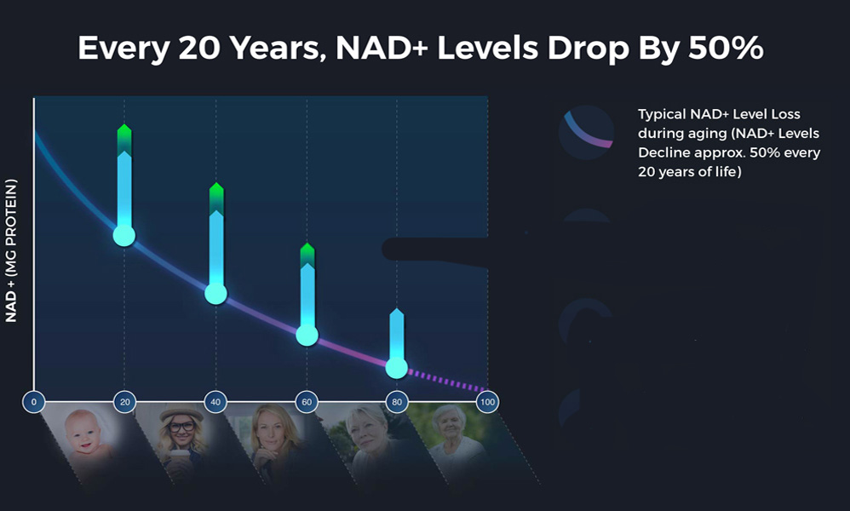
Fundamental NAD+ Stories
3rd Annual
NAD⁺ Summit
The “Declining NAD⁺ Story”

Slide 25
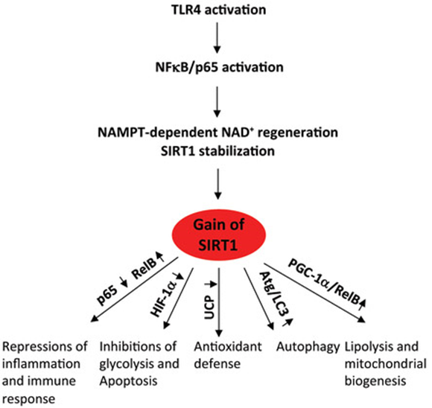
Fundamental NAD+ Stories
3rd Annual
NAD⁺ Summit
The “Declining NAD⁺ Story”
Nice Normal Tale:
When the nad salvage cycle
is working well and there is
plenty of sirt1, lots of good
stuff happens.
Even when triggered
By inflammation
Scary, Horrible Tale:
When NAD+ is scarce due to aging, sickness, competiton or pac-men factors, and sirt1 is scarce, expect the opposite consequence

Slide 26
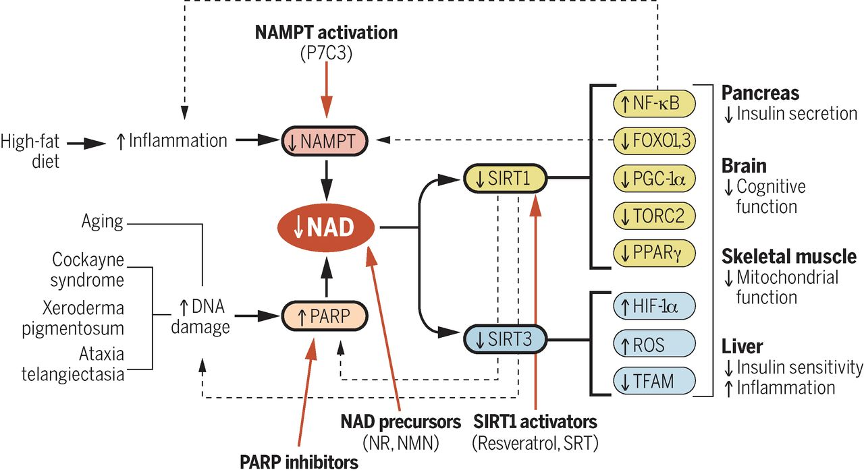
Fundamental NAD+ Stories
3rd Annual
NAD⁺ Summit
The “Declining NAD+ Story”
With aging there is
not enough NAD+
to satify the multiple
needs for it. its usages
in the body are triggered
and rationed, with
negative conseques
across the body.
Declining NAD+ Induces a Pseudohypoxic State Disrupting Nuclear-Mitochondrial Communication during Aging

Slide 27
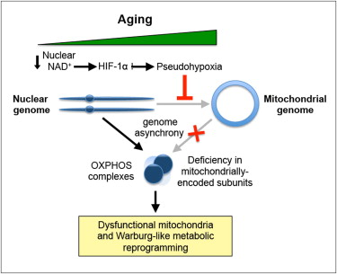
Fundamental NAD+ Stories
3rd Annual
NAD⁺ Summit
The “Declining NAD⁺-Pseudohypoxia Story”
Declining NAD⁺ in Aging
& Mitochondrial Dysfuction
A specific decline in mitochondrially
encoded genes occurs w/muscle aging
Nuclear NAD+ levels regulate mitochondrial
homeostasis independently of PGC-1α/β
Declining NAD+ during aging causes
pseudohypoxia, which disrupts OXPHOS
function
Raising nuclear NAD+ in old mice with
intraperitoneally administered NMN
temporarily reversed pseudohypoxia
and mitochondrial dysfunction
Ref: Gomes, et.al. Declining NAD+ Induces a Pseudohypoxic State Disrupting Nuclear-Mitochondrial Communication during Aging,
Cell, December, 2013, Volume 155, pp 1624-1638.

Slide 28
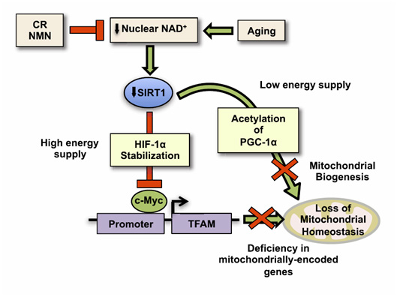
Fundamental NAD+ Stories
3rd Annual
NAD⁺ Summit
The “Declining NAD⁺-Pseudohypoxia Story”
How a Decline In Nuclear NAD⁺
Causes Mitochondrial Dysfuction
Decline in nuclear NAD+ occurs
with aging and overeating
This produces a decline in SIRT1
activity, which has 2 consequences:
  1. HIF-1 stabilization
  2. Lack of deacetylation of PGC-1α
This inhibits c-Myc activation of
TFAM, which is the transcription
factor for mitochondrial genes
Loss of PGC-1α activation further
stops mitochondrial biogenesis

Slide 29

THE Low NAD⁺ CHAMBER OF HORRORS
3rd Annual
NAD⁺ Summit
Inadequate Sirtuin function – SIRT1, SIRT2, SIRT3, SIRT4, SIRT5, SIRT6, SIRT7
Inadequate PARP function – PARP1, PARP2, PARP3, etc. Tankyrases
Inadequate DNA repair – PARPs and SIRTs needed for DSB repair
Genomic Instability => aneuploidy, gene
mutations, polyploidy, etc.
Mitochondrial biogenesis fails => no ATP
Mitochondrial dysfunction/death => no
ATP, no fat β-oxidation, apoptosis
Excessive mitochondrial ROS => aging
Warburg metabolism => lactic acidosis
Compromised stress resistance
Low
NAD⁺
NADH
ratio

Slide 30
THE low NAD⁺ CHAMBER OF HORRORS
3rd Annual
NAD⁺ Summit
Cellular senescence – increased SASP, chronic
tissue inflammation, aging
Impaired autophagy – no clearance of old
mitochondria, misfolded proteins, etc.
Endoplasmic reticulum stress => cell death
Failure of histone deacetylation => epigenetic
and circaidian gene regulation fails
Reduced antioxidant defenses => ROS
damage, lipid oxidation, protein carbonylation
Microtubule “railway” transport failure =>
axon transport failure in the CNS
Inflammasome activation
Impaired misfolded protein clearance
Inactivated tumor suppressor proteins – Ex: p53
Low
NAD⁺
NADH
ratio

Slide 31
Pacmen who eat NAD+ Stories
3rd Annual
NAD⁺ Summit
PARP enzymes
CD38 enzymes
High fat diet
NQO1 problem

Slide 32
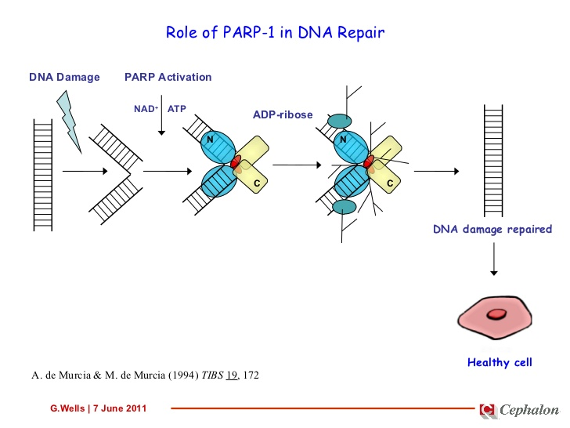
Pacmen who eat NAD+ Stories
3rd Annual
NAD⁺ Summit
The “PARP-consuming NAD⁺ Story”
PARPs 1 and 2 are nuclear
enzymes that are implicated
in many cellular processes
including DNA repair
DNA damage is a relatively
common event in the life of
a cell and may lead to mutation,
cancer, and cellular or organismic
death.
An important cell response to
DNA damage is PARP activation,
which consumes massive
amounts of NAD+
PARP hyperactivation occurs
with crystal meth use
DNA Damage and massive NAD+ consumption by PARPs

Slide 33
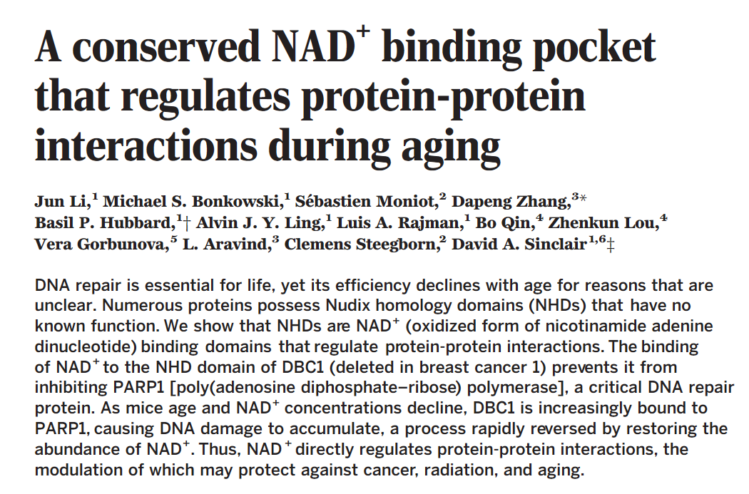
A New NAD+ StorY from 2017
3rd Annual
NAD⁺ Summit
How NAD⁺ binds in a pocket between DBC and PARP
The Nudix Homology Domain
A new function of NAD+
DBC is an inhibitor of PARP1 , which prevents DNA repair
With aging NAD+ concentrations decline, DBC1 is increasingly bound to PARP1, compromising PARP1 DNA repair and causes DNA damage to accumulate
This process can be rapidly reversed by restoring the abundance of NAD+

Slide 34
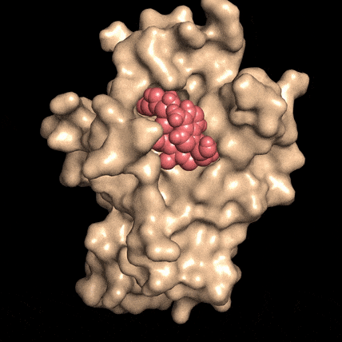
A New NAD+ StorY from 2017
3rd Annual
NAD⁺ Summit
How NAD⁺ binds in a pocket between DBC and PARP
The Nudix Homology Domain
A new function of NAD+
The Nudix Homology Domain (NHD) is simply a binding pocket formed by two proteins
Unless the two proteins are bound together, the “pocket” cannot be visualized or detected in the lab
This is why this new role of NAD+ remained unknown for so long
NAD⁺

Slide 35
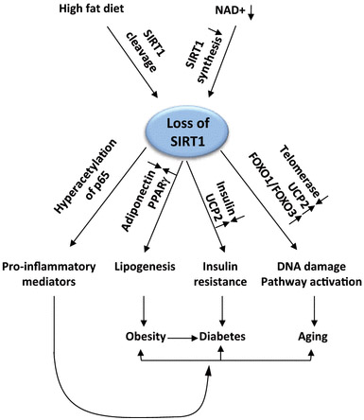
Fundamental NAD+ Stories
3rd Annual
NAD⁺ Summit
Fat: The “Dietary NAD⁺ Destroyer”
How To Destroy all your
NAD⁺ at the Dinner Table!
High fat diet triggers SIRT1 cleavage
=> destroying all of the SIRT1 function
SIRT1 loss triggers 4 bad things:
1. Inflammation (IL-6, TNF-α, IL-1β, etc.)
2. Fat generation (via adiponectin, PPARγ)
3. Insulin resistance (via UCP2)
The pro-inflammatory cytokines have a “positive
feedback” on the formation of obesity, diabetes,
and aging

Slide 36
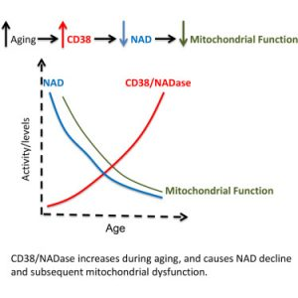
pacmen who eat NAD+
3rd Annual
NAD⁺ Summit
CD38: The “Extracellular NADase Story”
Why IV NAD⁺ can be DESTROYED before it even enter the Cell (Brain)
CD38 is one of several “ectoenzymes” found outside the cell that are
CD38 is probably the #1 Extracellular
“NAD consumer” (PARPs are the #1
intracellular consumer, under normal
conditions)
CD38 consumes NAD⁺ and makes cyclic-ADP ribose (cADPR), but does
this every inefficiently!
CD38 gene expression increases
with aging, exacerbating the problem

Slide 37
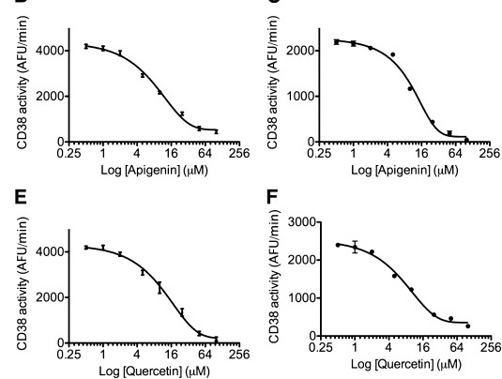
Fundamental NAD+ Stories
3rd Annual
NAD⁺ Summit
CD38: The “Extracellular NADase Story”
How to Blog NAD⁺ from being destroyed by CD38!
CD38 can be blocked by natural compounds, founded in apple skins
Apigenin, flavonoid found in apple skins. It is a powerful inhibitor of CD38.
Treatment of cell cultures with apigenin increased NAD levels in the cells, reduced global acetylation of proteins, and reduced the acetylation of p53 and RelA-p65 subunits of NF-kB.
Quercetin is also a powerful inhibitor of CD38 in-vitro as well.

Slide 38
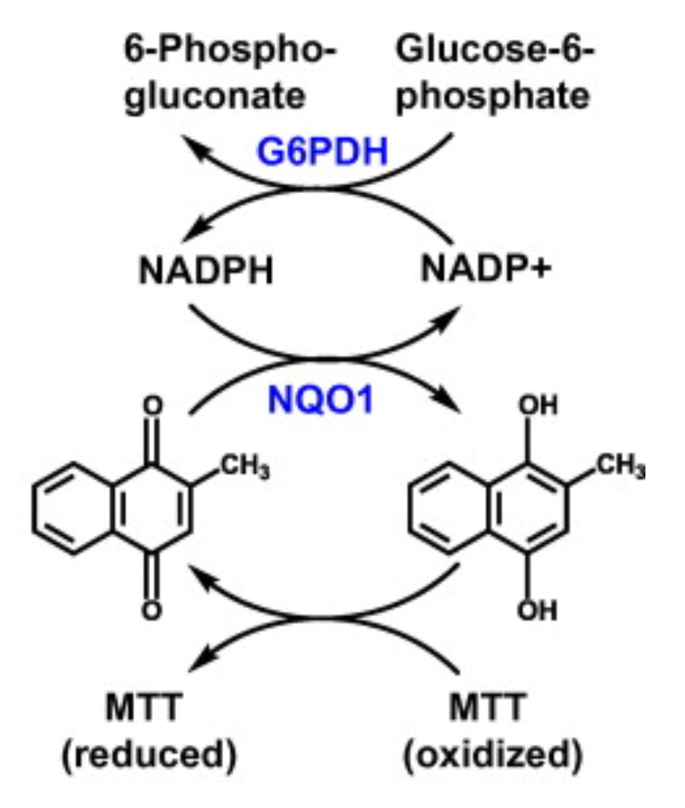
3rd Annual
NAD⁺ Summit
Fundamental NAD+ Stories
NQ01: The NAD+/NADH ratio destoyer”
What is of prime importance for health and longevity may not be the actual concentration of NAD+ in cells or cell nuclei, but rather the NAD⁺/NADH ratio
This ratio may not be affected by NAD⁺ precursor supplements or the rate of production of NAD+, and rather be driven by other matters such as expression of the NQ01 gene, a “longevity gene”
NQ01 stands for a gene and protein NAD(P)H: quinone oxidoreductase 1 that is induced by Nrf2 but down-regulated by “epigenetic reader” proteins known as BET proteins.
Expression of the NQ01 gene drops off with aging.

Slide 39
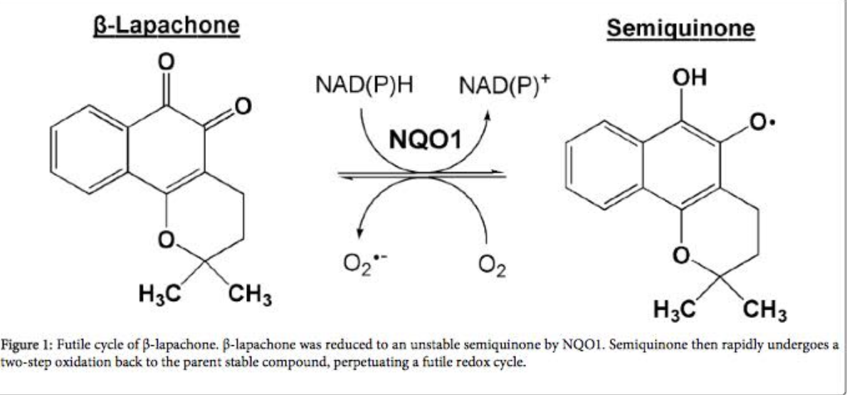
Fundamental NAD+ Stories
NQ01: The NAD⁺/NADH ratio destoyer”
NQO1 regulates the ratio of NAD/NADH
and the ratio of NADP/NADPH by oxidizing
NADH to NAD+, the needed form.
NQO1 is one of the few proteins that
oxidizes NADH to NAD+
Thus NQ01 regulates aging independently of NAD content.
The longevity gene NQO1 regulates blood
pressure by eNOS, ACE, and an LKB1/AMPK-
mediated preservation in GTPCH-1
B-Lapachone, a product from the Lapacho tree
found in the Andes, solves the NAD/NADH ratio
problem by triggering “futile cycling” of B-lapachone)

Slide 40

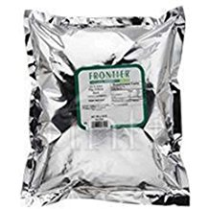
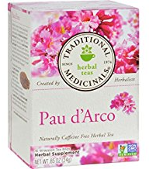
Fundamental NAD+ Stories
Upregulating NQ01 with a Natural Product
NQ01 is an “antioxidant response element” gene activated by Nrf2 and the many natural processes and phytosubstances that activate Nrf2
E.g. quercetin increases Nrf2-mediated gene expression of NQO1.
Beta-lapachone in particular increases NQO1 enzyme activity, a fact established by multiple studies
Beta lapachone is found in the bark of the lapacho tree, is possibly in lapacho tea
But probably not in a concentration sufficient for drinking lapacho tea to make a difference by upregulating the NQ01 gene

Slide 41

Fundamental NAD+ Stories
Upregulating NQ01 with a Natural Product
Research establishes beta lapachone in rats
  elevates the ratio of NAD/NADH in endothelial cells
  increases eNOS activity via an AMPK-dependent mechanism
As a consequence, reduces blood pressure
  The elevation in the NAD/NADH ratio also results in a reduced cleavage and secretion of ACE into the bloodstream, thereby reducing Angiotensin II formation.
As a result of the eNOS-mediated method and the ACE-reduction mediated molecular mechanism, resolved hypertension in rats.
As a result of all this research, NQO1 activation has been recently proposed as a strategy for controlling hypertension
Β-lapacho Tree

Slide 42
Conclusions and Practical Consequences
1. Horrible things can and will happen if you do not have enough NAD+or you’re NAD+/NADH ratio is too low.
2. Most of the NAD+ you depend on is recirculated in the NAD Salvage cycle.
3. The extended version of the NAD Salvage cycle involves several other Cycles including ones connected with circadian rhythms, and with mitochondrial well being and mitochondrial biogenesis.
4. Important actors in The NAD Salvage cycle and in the biological activities of NAD are the sirtuins, sister enzymes that are responsible for many of the impacts of normal or too low NAD+..
5.Many things can go wrong in these Cycles which feed upon and affect each other, and these things can result in too low NAD+. There are many NAD+ Pac Men factors.

Slide 43
Conclusions and practical interventions
6. Because there is much positive feedback among these Cycles if something goes wrong, and there are many many opportunities for this to happen,, the body may not be able to restore healthy NAD+ and NAD+/ NAD ratios without an extraordinary intervention. The NAD salvage cycle possibly requires rebooting. This may not be possible through normal interventions such as dietary ones.
7. I strongly conjecture that IV NAD infusions are now the best and possibly only way to provide such a rebooting intervention. Clinicians who are involved with NAD infusions at this conference have told me that they definitely have noticed a switching process that often takes place as a result of an infusion to a basically more healthy constitutional state.

Slide 44
Conclusions and practical interventions
8. To maintain a healthy NAD÷ state and mitigate a number of Pac Man factors there are of course many things that can be done, starting of course with respecting healthy sleep, dietary and lifestyle patterns. Dietary supplements that could be a significant help could include NR, resveratrol. Apigenin, and many other plant polyphenols. Again, health of the processes that produces NAD depends on health of numerous other body pathways.
9. I believe the control of chronic systemic inflammation is an additional key factor in maintaining health especially in aging. And there are some important things that can be done about that as well. That is another very important conversation.

Slide 45
Aging ScienceS core team:
James P. Watson, M.D.
Melody Winnig, M.I.S.
Michael Giuliano, M. S.
Vince Giuliano,PhD
For More Informationgeneral on NAD+ Biology and Aging
www.agingsciences.com
Again, thqnks to Jim Watson for his incredible contribution to making this presentation and to me in general,
Thanks to our many associate research writers

